Slide 1
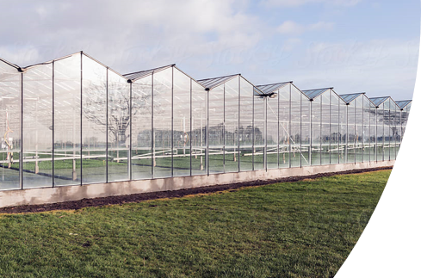
Sin Greenhouse
Projectweek 2022 - Sprint 2

Slide 2
The Problem
Problem Statement
What problem is the project trying to solve?
Industrial networks are often not as secure as we think, as well as not encrypted and we demonstrate this using a test setup.
Goal:
Manipulate states of devices on the PLC by sending data to the PLC. And showing on a securityapp (js) and dashboard (Node-Red).
Problem

Slide 3
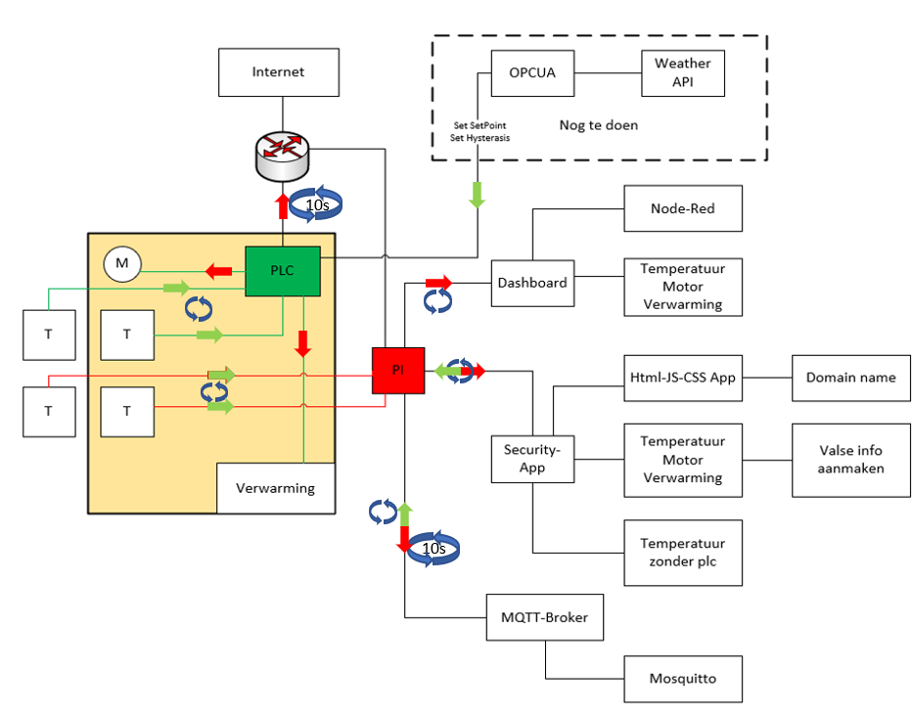
Scheme
Implementation
Overview of the Greenhouse

Slide 4
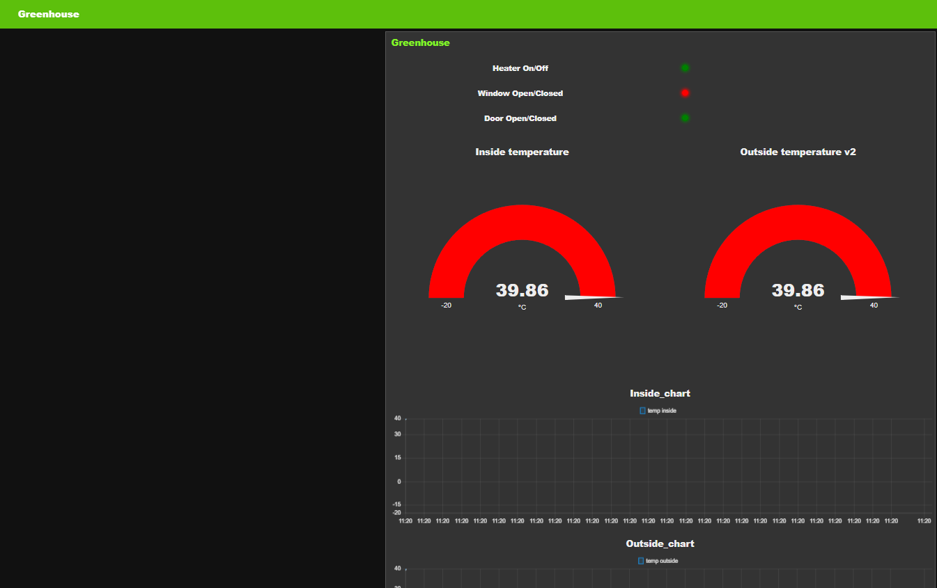
Node-Red
Dashboard
Dashboard

Slide 5
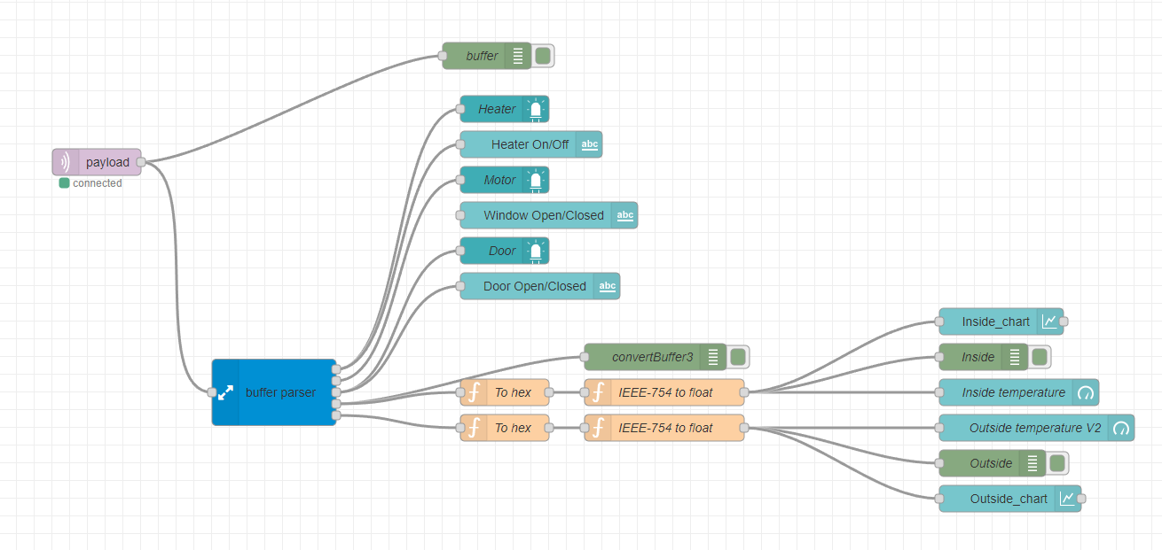
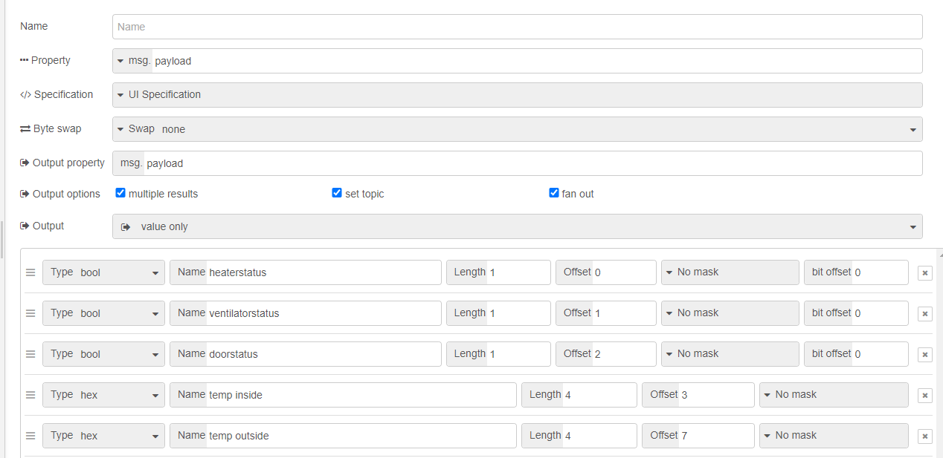
Node-Red
Dashboard
Dashboard

Slide 6
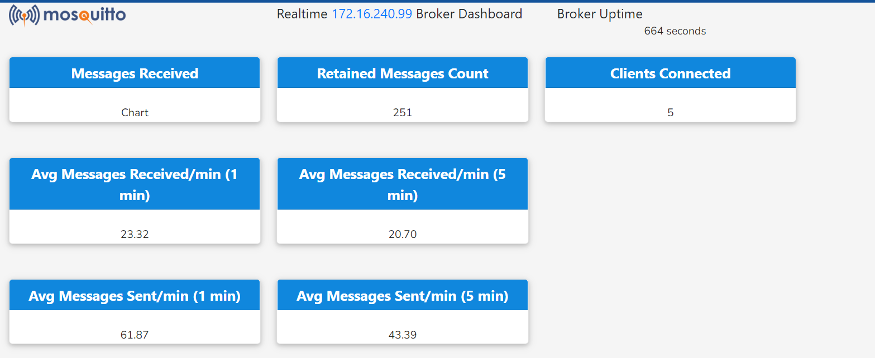
Security App
js
Showing data of temperature sensor
Showing data of:
Heater
Motor
Door
Manipulating the data via mqtt
Security App

Slide 7
OPCUA
(Adjusting data on plc with freeOPC)?
Fetch weather from API
Send data
Set Setpoint
Set Hysteresis
to OPCUA server and connect plc as client to server
Img.

